Slide 1

GOVERNMENT COLLEGE OF ENGINEERING-ERODE
WEB DESIGN USING AWS CLOUD
Project Guide : Dr. K. MURUGAN ME. Ph.D.,
Submitted By
R . Kanishka 731120205015
V . Aruna 731120205002
M. Priyadharshani 731120205025

Slide 2
Develop a Tourism Website And Deploy in AWS Cloud
The project travel and tourism information website to know about the places to all over the world to visit.
The website have both frontend and backend. The frontend is designed on html ,css and javascript .
The backend is designed on AWS cloud using S3 bucket.
The aim of the project is to explore the worlds wonderful places to visit and enjoy the travel around the world.

Slide 3
PROBLEM STATEMENT
The travel website has been developed using HTML, CSS, and JavaScript and needs to be hosted on AWS cloud to provide a scalable and reliable infrastructure that can handle high traffic.
The challenge is to design and implement an AWS-based solution that can host the website and provide the necessary resources to support its features while optimizing cost and performance.
This includes setting up a web server, database, load balancer, and CDN, as well as configuring security and monitoring tools to ensure the website's availability and reliability.

Slide 4
REQUIREMENTS
Software Requirements :
Windows 11
AWS
Leaflet
S3 Bucket

Slide 5
FRONTEND
HTML (Hypertext Markup Language) is a markup language used for creating and structuring content on the web.
It provides a set of tags and attributes that are used to define the layout and formatting of web pages. HTML documents are created using a text editor and saved with the .html extension.
CSS (Cascading Style Sheets) is a style sheet language used for describing the presentation and formatting of HTML documents.
CSS allows web developers to separate the content and structure of a document from its presentation and styling.
CSS is used to apply styles such as colors, fonts, margins, and borders to HTML elements.

Slide 6
JAVASCRIPT
JavaScript is a high-level, dynamic, and interpreted programming language used for creating interactive and dynamic web pages.
JavaScript is mainly used to add interactivity to web pages, such as form validation, animations, and interactive menus.
JavaScript code can be embedded in an HTML document using the <script> tag or it can be included in a separate file and linked to the HTML document using the <script> tag.
JavaScript has a number of built-in functions and methods that can be used to manipulate data, such as string manipulation functions and array manipulation methods.

Slide 7
BACKEND
Cloud computing means storing and accessing the data and programs on remote servers that are hosted on the internet instead of the computer’s hard drive or local server. It is also referred to as Internet-based computing.
Amazon Web Services (AWS) is the world’s most comprehensive and broadly adopted cloud, offering over 200 fully featured services from data centers globally. Millions of customers including the fastest-growing startups, largest enterprises, and leading government agencies are using AWS to lower costs, become more agile, and innovate faster.

Slide 8
AWS S3 BUCKET
AWS S3 bucket is an open distributed storage resource accessible in Amazon Web Services (AWS) Simple Storage Service (S3), an item stockpiling offering. Amazon S3 buckets, which are like record organizers, store objects, which comprise of information and its clear meta data.

Slide 9
LEAFLET JAVASCRIPT MAP
Leaflet is a popular JavaScript library for interactive maps.
We create a Leaflet map instance and set it to a specific latitude and longitude using the setView method. Then, we create a tile layer using OpenStreetMap as the source for the map background. We add the tile layer to the map using the addTo method.
Feel free to customize the map options, such as the initial coordinates, zoom level, tile layer, and additional markers or overlays, based on your requirements.

Slide 10
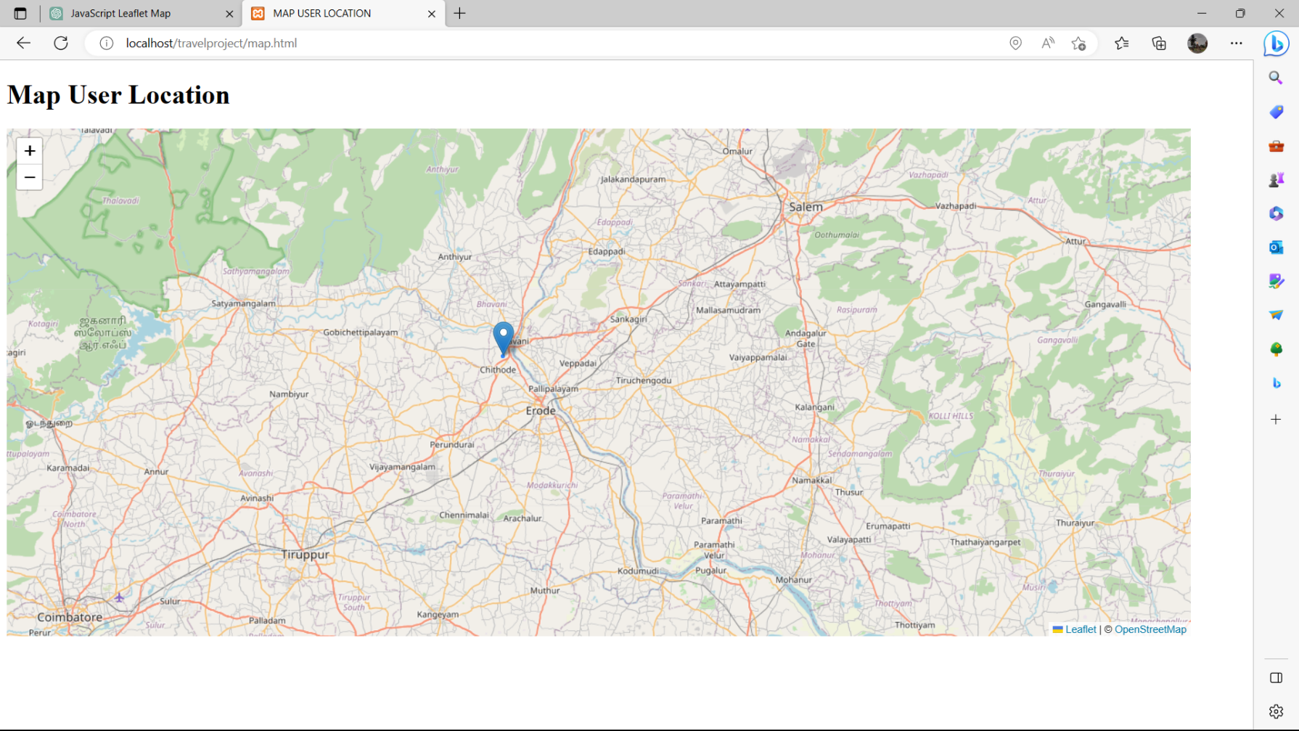
EXAMPLE

Slide 11
HOME PAGE
It contains the menu and header bar. It connect to all other about , destination and feedback pages.
Home page contain some information about the tourism and destination information
About page contain the some information about the our website.
Destination page have several destination to visit and enjoy the holidays . At same time we provide a location of the places using leaflet map.

Slide 12
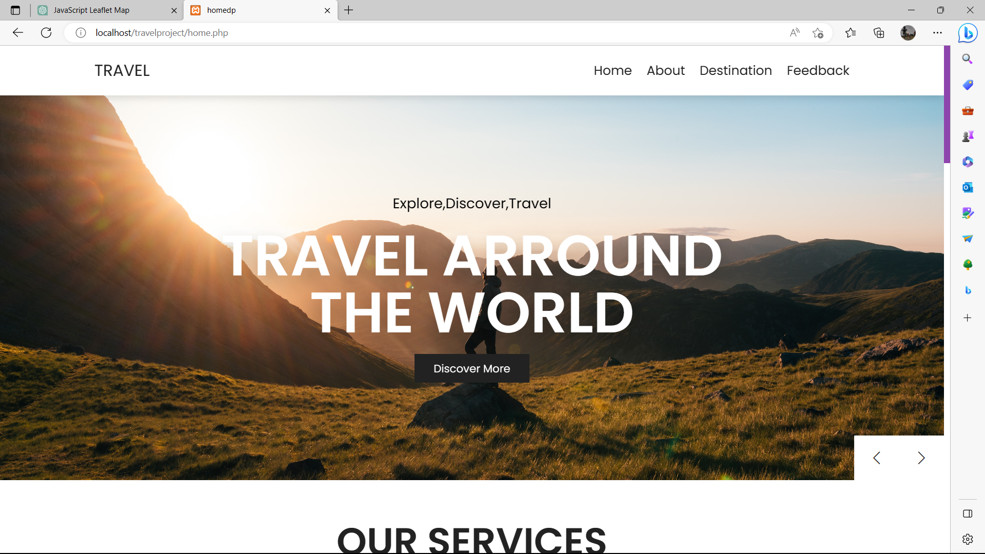
HOME PAGE

Slide 13
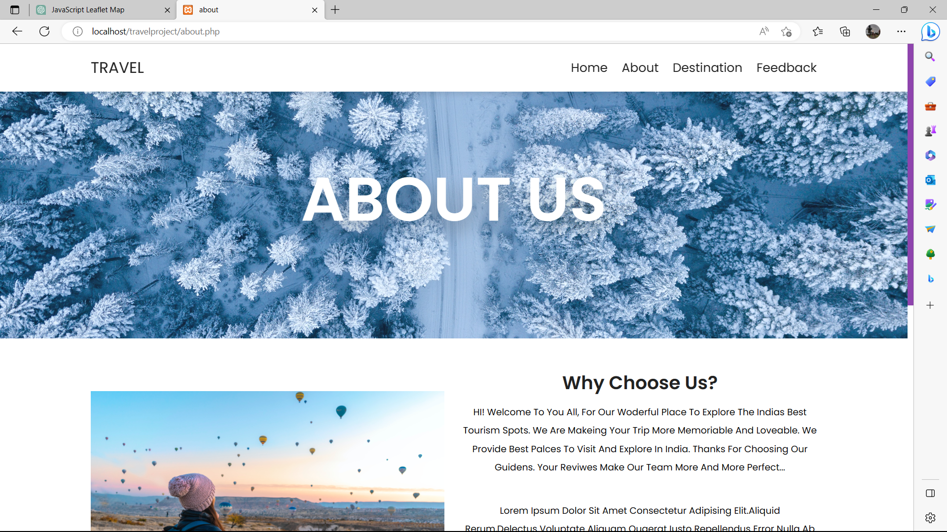
ABOUT

Slide 14
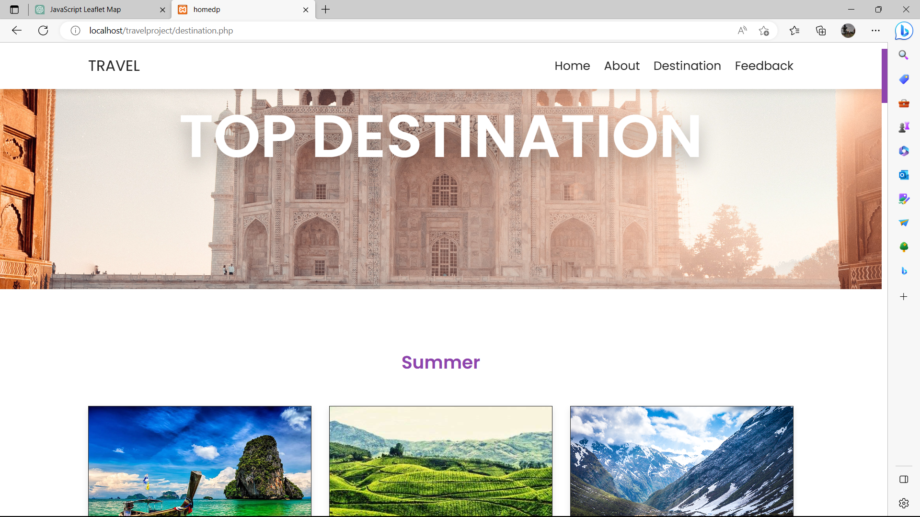
DESTINATION

Slide 15
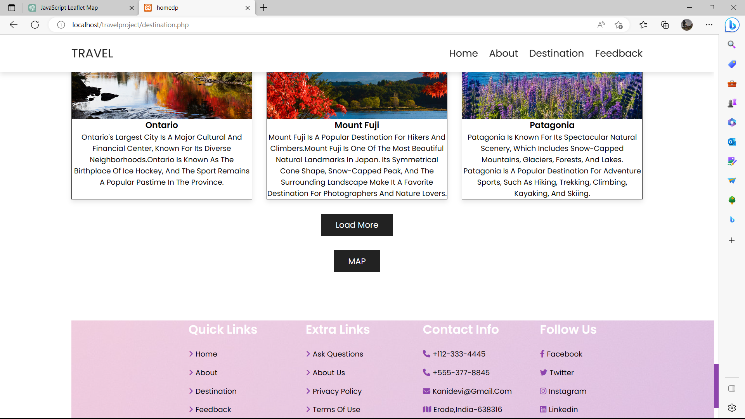
DESTINATION

Slide 16
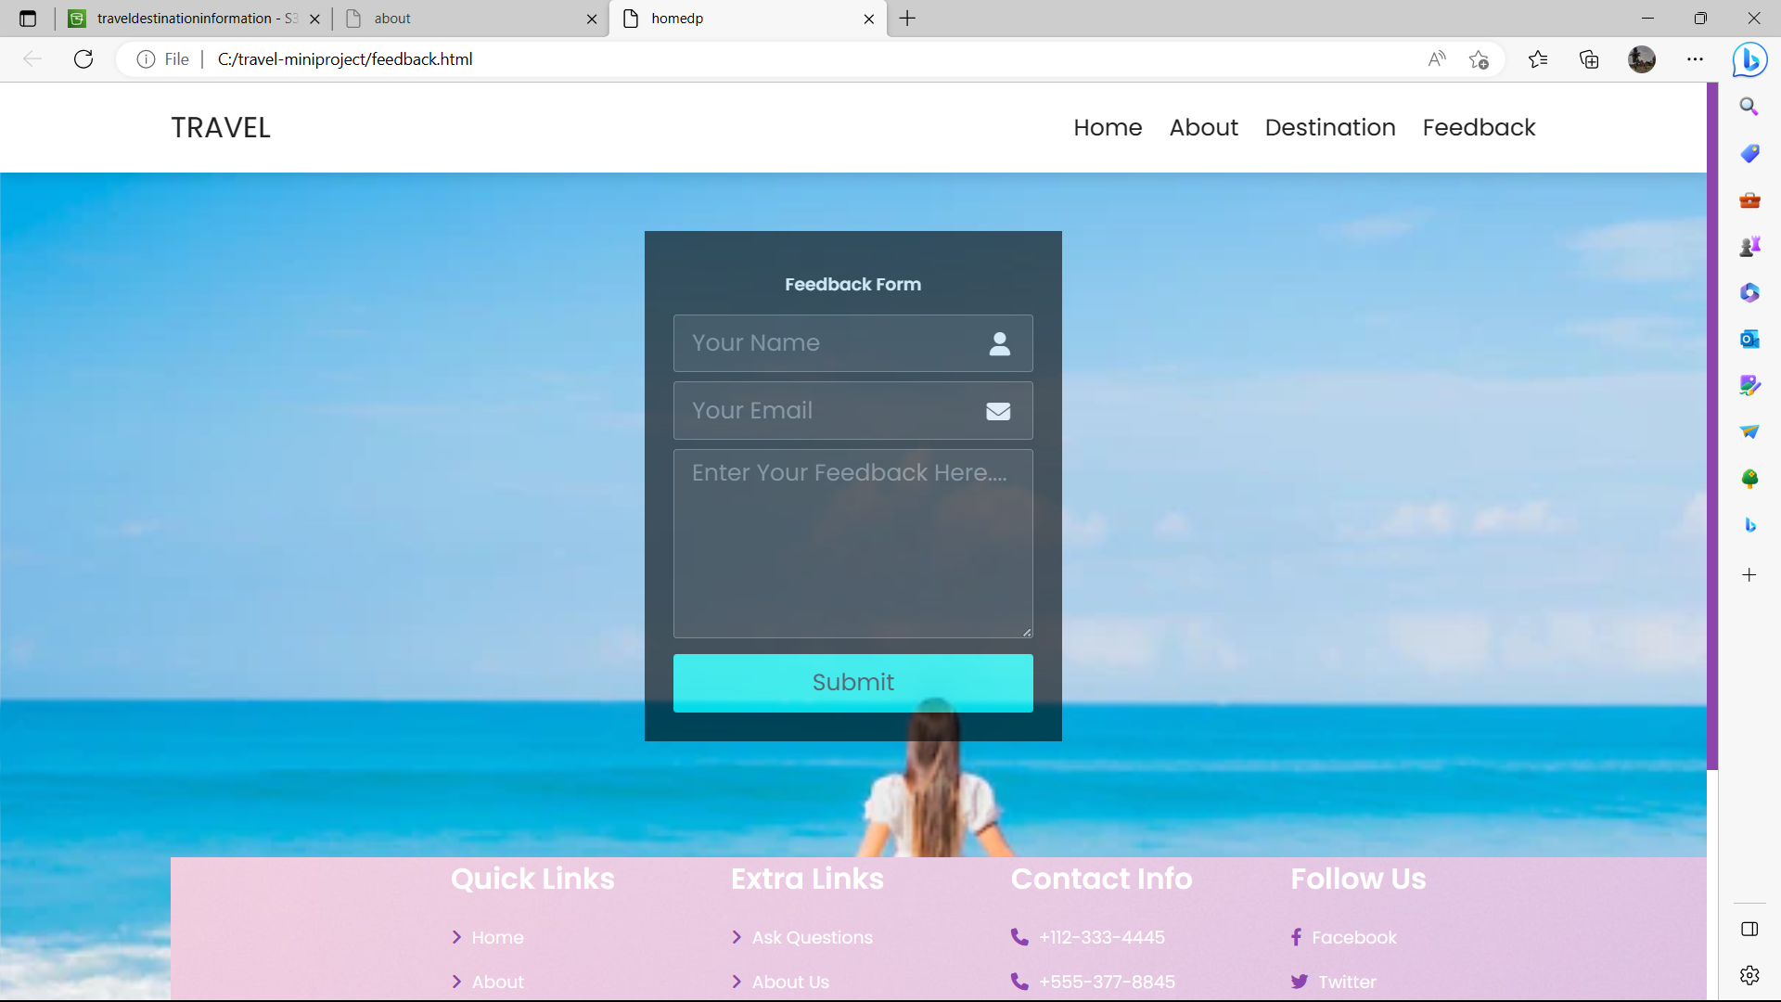
FEEDBACK

Slide 17
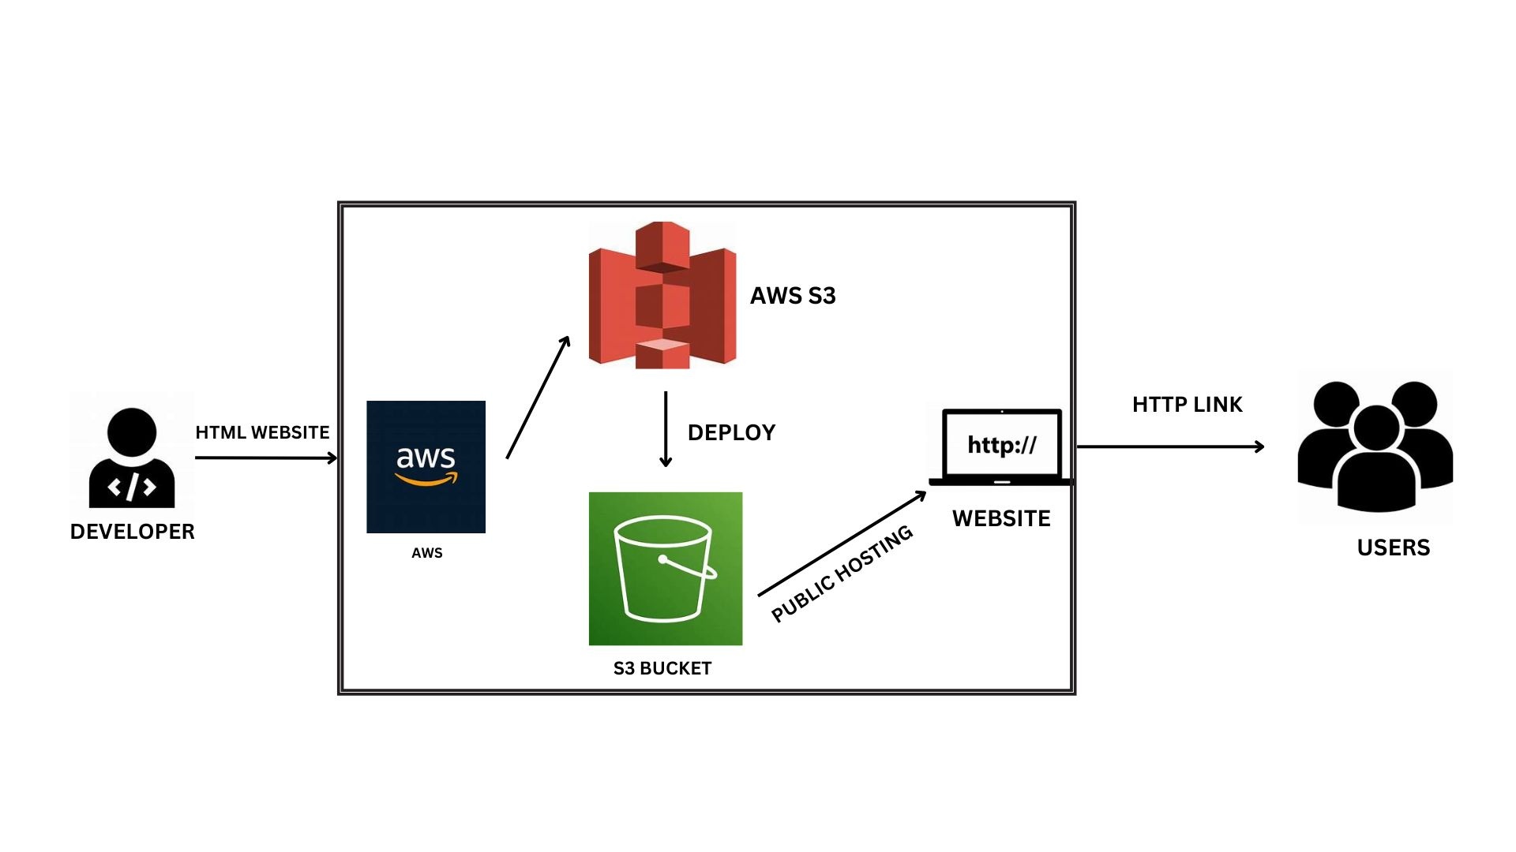
ARCTECTURE DESIGN

Slide 18
S3 BUCKET
Create an S3 bucket for hosting the website and uploading content.
Bucket name- travel destination information.
Region name- .ap-south-1 region
Enable static website hosting- Off for Block all public access.
Upload all html, css and javascript file and also upload the images folder.
Enable static website hosting.
Website Link : http://traveldestinationinformation.s3-website.ap-south-1.amazonaws.com

Slide 19
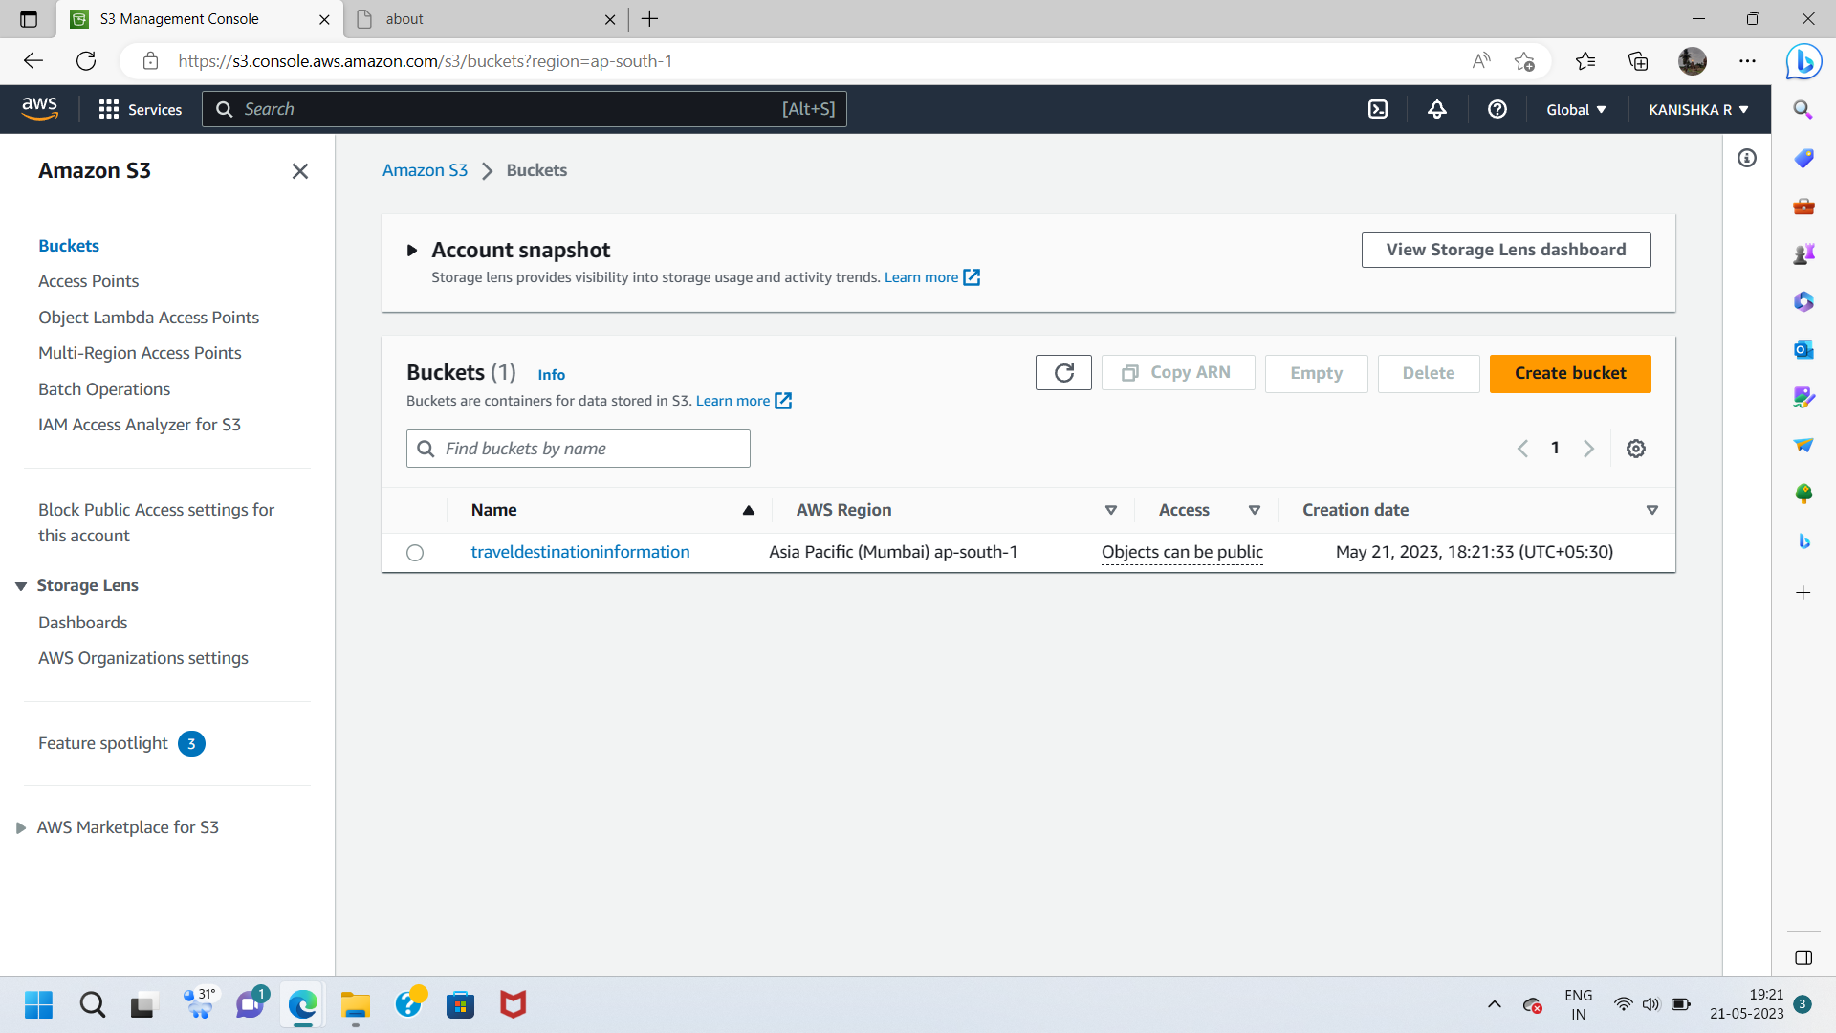
S3 BUCKET

Slide 20
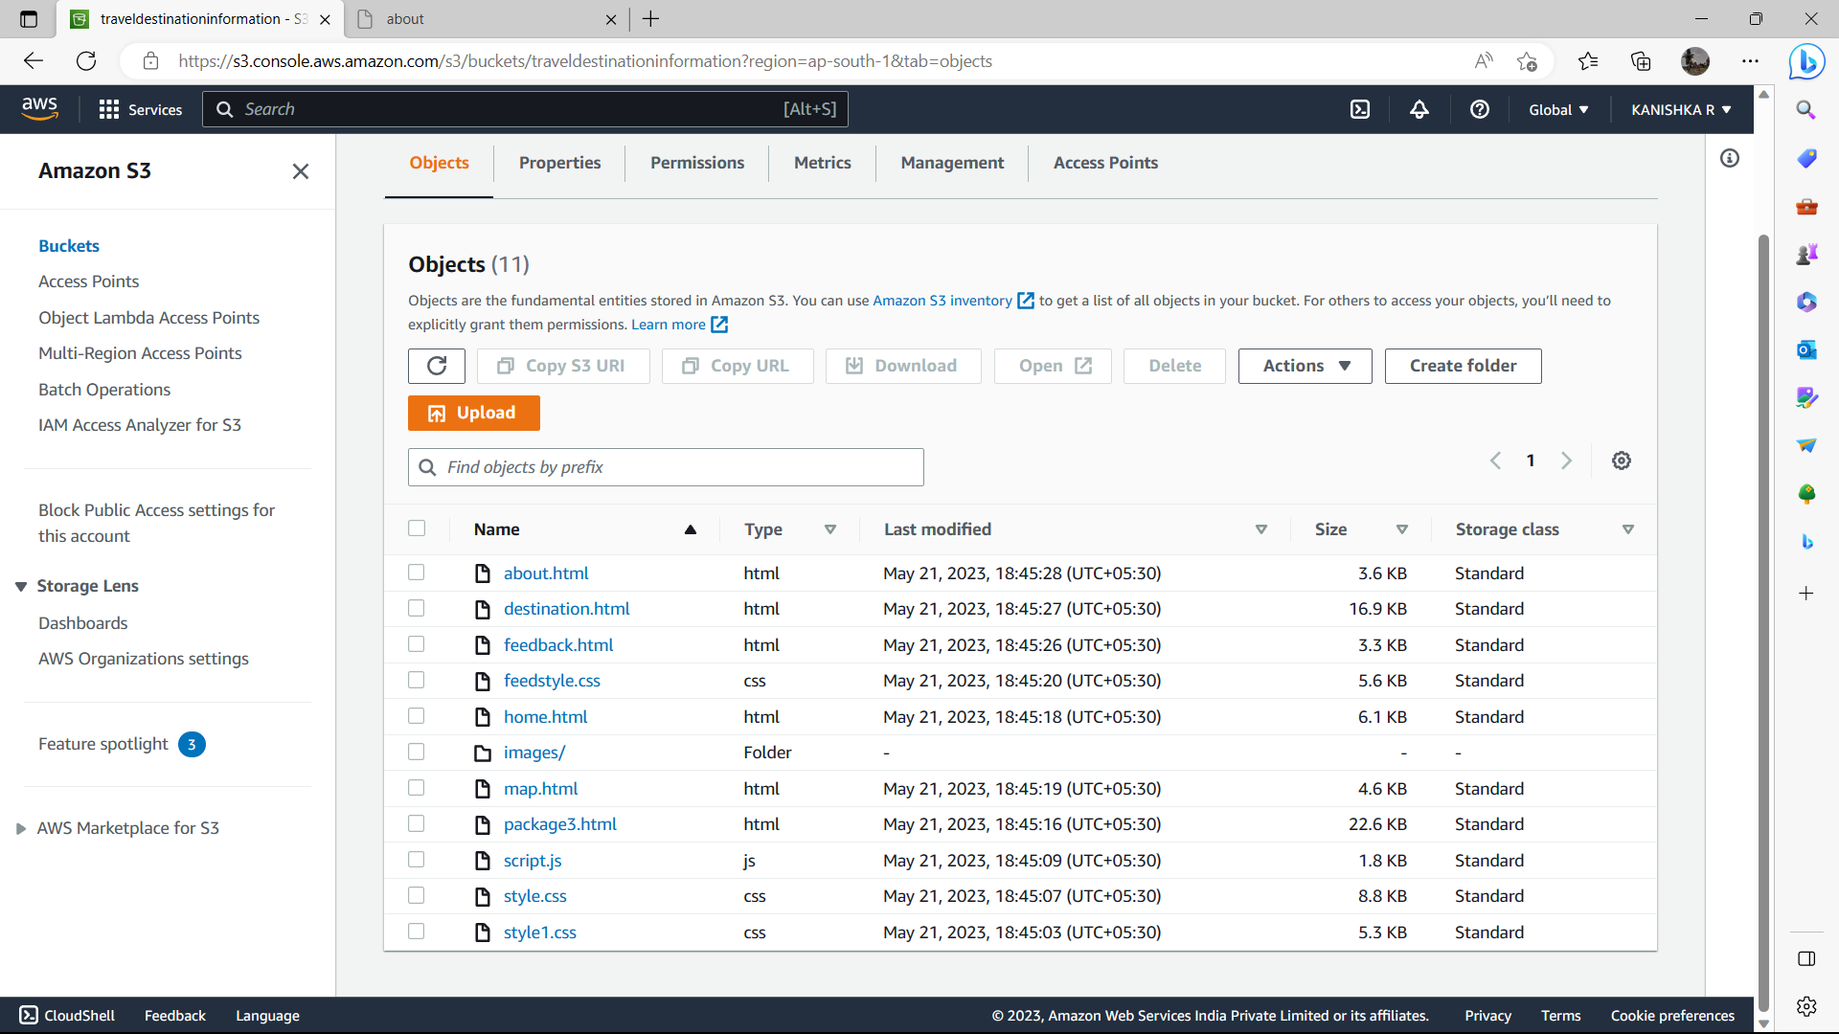
S3 BUCKET

Slide 21
ADVANTAGES
Convenience: Users can access these websites from anywhere and at any time, allowing them to explore various options according to their preferences.
Travel Planning Tools: Many travel websites offer useful planning tools such as interactive maps and recommendations for popular attractions and activities.
Time Saving: Users can quickly find and compare options on a single platform.
Flexibility: Using interactive map, users can see the season-wise places.

Slide 22
DISADVANTAGES
Information Overload: With a vast amount of information, users may feel overwhelmed and find it challenging to make decisions.
Online Connectivity: Using travel websites heavily relies on having a stable internet connection. In areas with limited or unreliable internet access, users may face difficulties in accessing travel websites and researching options.
Lack of Human Interaction: Travel websites, by nature, have limited human interaction, which may not be ideal for individuals seeking a more personalized experience or those who require specific assistance.

Slide 23


